Slide 1
Model Building Phase
Impact of an Incident Prediction Project
- By Ashish Gore

Slide 2
Data Cleaning Phase
01
Dimensionality Reduction
02
Algorithms
Train & Test
Splitting
Project Approach
04
03
Meta Algorithms &
Neural Networks
05
Cross Validation &
Hyperparameter Tuning
06
Feature Selection, Conversion
Into Dummies
Which Method & Why?
Multiple Algorithms Used
& Their Accuracies
Sampling Methods for
Imbalanced Data
Multiple Meta Algorithms & NN Used & Their Accuracies
Which Method & Why?

Slide 3

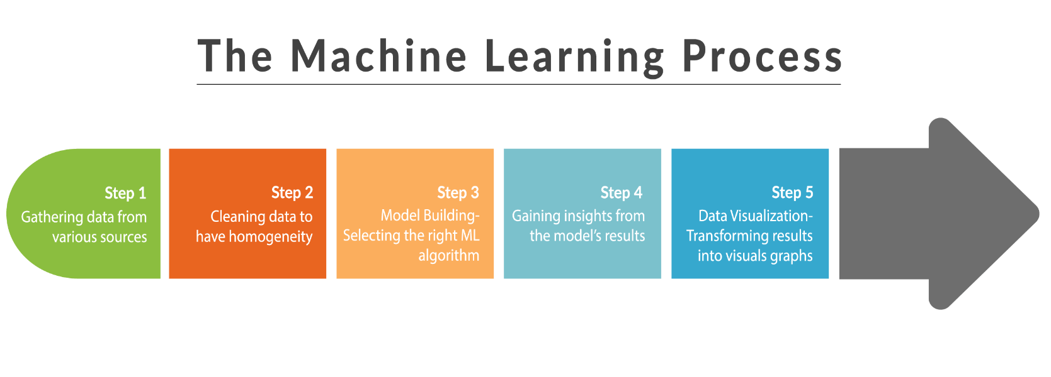
The Machine Learning Process``

Slide 4
01
Data Cleaning Phase

Slide 5
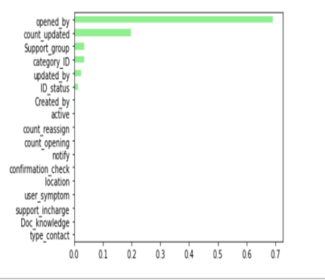
Feature Selection
Removed -100 Class from “ID_Status” Feature
Selected only Important Features

Slide 6
Conversion Into Dummies
Each Class Converted into Separate Dummies
Resulting Dimensions (141707, 534)

Slide 7
02
Dimensionality Reduction

Slide 8
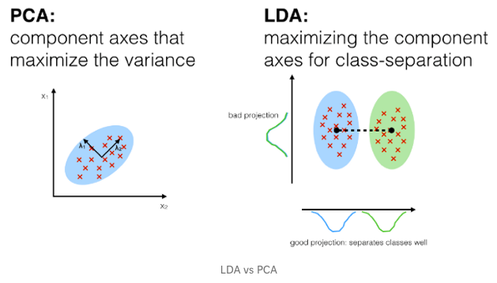
Dimensions Reduced:
From To
534 => 15
(100%) (98%)

Slide 9
Difference between two techniques
LDA( Linear Discriminant Analysis) | PCA(Principal Component Analysis)
1. LDA is a supervised machine learning method that is used to separate two groups/classes. | 1. PCA is an unsupervised machine learning method that is used for dimensionality reduction.
2. LDA attempts to find a feature subspace that maximizes class separability (variance) | 2. PCA as a technique that finds the directions of maximal variance:
3. LDA looks at what type of point/ features subspace gives more discrimination to separate the data. | 3. Variables are transformed into a new set of variables which is a combination of attributes from our original dataset in a way that maximum variation is retained. It is not a feature selection technique.
Notes:
PCA: is not a feature selection. Rather, it is a feature combination technique. Because each PC is a weighted additive combination of all the columns in the original dataset.

Slide 10
Which Technique did we Choose?
Why?
We Choose Both PCA & LDA Technique

Slide 11
Do you want to reduce the no.of variables, but are not able to identify variables to completely remove from consideration?
Do you want to ensure your variables are independent of one another?
Are you comfortable making your independent variable less interpretable?
WHY should you use LDA?
LDA is a type of Linear combination, a mathematical process using various data items and applying a function to that site to separately analyze multiple classes of objects or items.
Fisher’s Linear discriminant, linear discriminant analysis can be useful in areas like image recognition and predictive analysis in marketing.
LDA helps in preventative data for more than two classes, when Logistics Regression is not sufficient. The linear Discriminant analysis takes the mean value for each class and considers variants to make predictions assuming a Gaussian distribution.
WHY should you we PCA?

Slide 12
03
Train and Test Splitting
Sampling and Scaling Methods

Slide 13
Scaling Techniques
Feature Scaling is a technique to standardize the independent features present in the data in a fixed range. It is performed during the data pre-processing to handle highly varying magnitudes or values or units.
1) Min Max Scaler
2) Standard Scaler
3) Max Abs Scaler
4) Robust Scaler
5) Quantile Transformer Scaler
6) Power Transformer Scaler
7) Unit Vector Scalar

Slide 14
Difference between Minmax and Standard
Minmaxscaler | Standardscaler
Minmaxscaler shrinks the data within the range of -1 to 1(if there are negative values) | Standard assumes that data has normally distributed features and will scale them to zero mean and 1 standard deviation.
This is used when distribution is not Gaussian, responds well if standard deviation is small. | After applying Standard Scalar all features will be of same scale .
This scaler is sensitive to outliers. | The outliers have an influence when computing the empirical mean and standard deviation which shrink the range of the feature values.

Slide 15
Sampling Techniques Available
Simple Random Sampling
Over Sampling
Under Sampling
2
1
2
3
2
1
3
1
3
1
2
3

Slide 16
Sampling Technique We Choose
Stratified Random Sampling
1000 Records
2
2
1
3
2
1
3
1
3
1000 Records
Original
700 Records
Train
300 Records
Test

Slide 17
04
Different ML Algorithms
Multiple Algorithms Used & Their Accuracies

Slide 18
Accuracies obtained using diff Algorithms
LDA | PCA
1. Decision Tree: Accuracy 0.94 | 1. Decision Tree Accuracy 0.94
2. Random Forest Accuracy 0.95 | 2. Random Forest: Accuracy 0.95
3. Support Vector Classifier Accuracy 0.95 | 3. Support Vector Classifier Accuracy 0.95
4. Gaussian NB Accuracy 0.92 | 4. Gaussian NB Accuracy 0.90
5. KNN Accuracy 0.95 | 5. KNN Accuracy 0.95

Slide 19
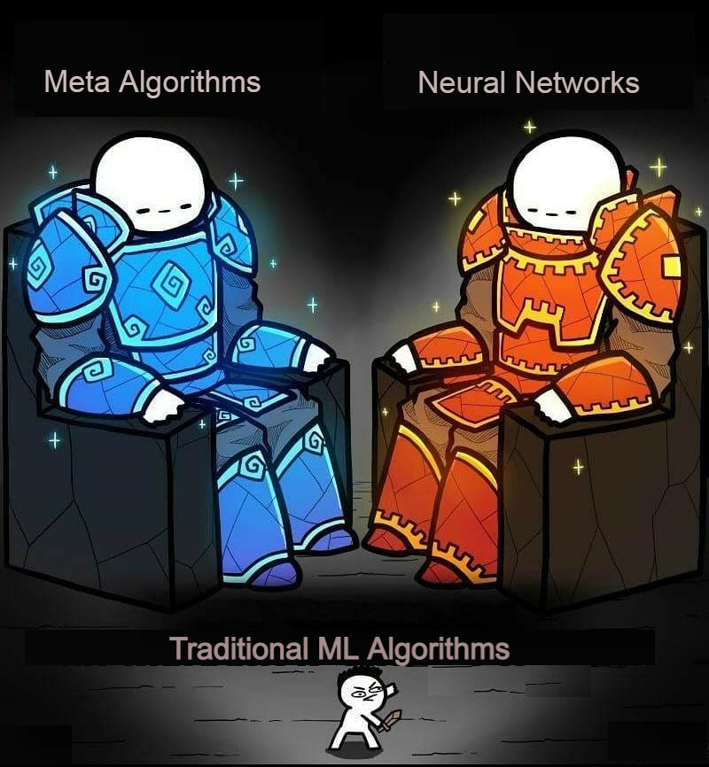
Traditional vs Advanced ML Algorithms

Slide 20
05
Meta Algorithms & Neural Networks
Multiple Meta Algorithms & NN used along with their Accuracies

Slide 21
Accuracies obtained using diff Meta-Algorithms
LDA | PCA
1. Voting Classifier Accuracy of Voting Classifier: 0.947 | 1.Voting Classifier Accuracy of Voting Classifier: 0.954
2. Bagging Classifier Accuracy of Bagging Classifier: 0.949 | 2. Bagging Classifier Accuracy of Bagging Classifier: 0.954
3. AdaBoost Classifier Accuracy of Bagging Classifier: 0.949 | 3. AdaBoost Classifier Accuracy of Bagging Classifier: 0.954
4. XGBoost Classifier Accuracy of Bagging Classifier: 0.953 | 4. XGBoost Classifier Accuracy of Bagging Classifier: 0.951

Slide 22
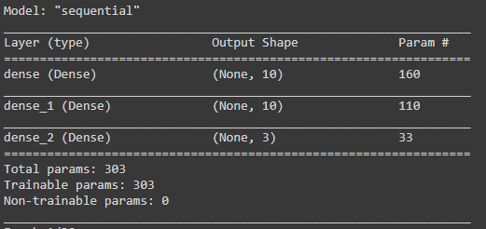
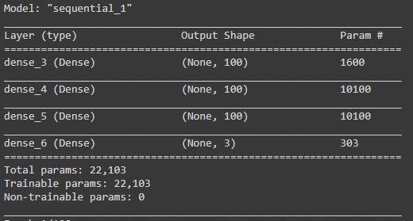
Neural Networks Model Building
NN Model 1
303 Params
NN Model 2
22,103 Params

Slide 23
06
Cross Validation & Hyperparameter Tuning

Slide 24
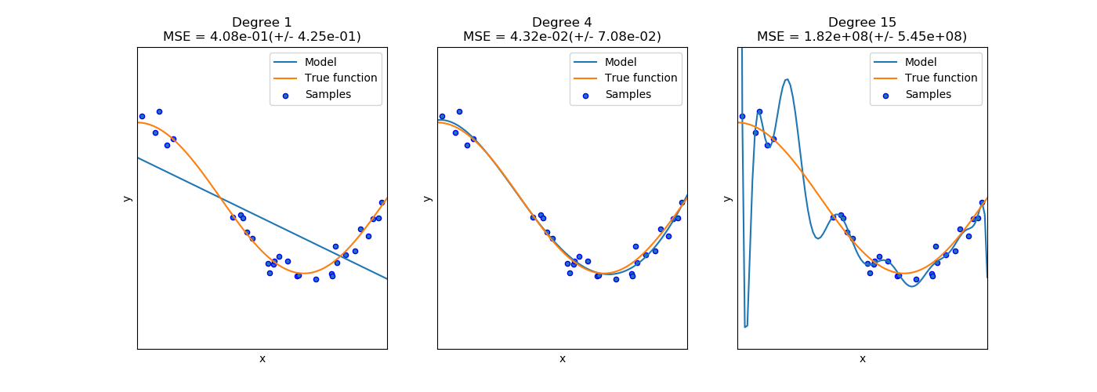
Cross Validation
Cross Validation is a technique used to identify how well our model performed and there is always a need to test the accuracy of our model to verify that, our model is well trained with data without any overfitting and underfitting.
In statistics, overfitting means our model fits too closely to our data. The fitted line will go exactly through every point in the graph. Underfitting means our model doesn’t fit well with the data(i.e, model cannot capture the underlying trend of data, which destroys the model accuracy)and occurs when a statistical model or machine learning algorithm cannot adequately capture the underlying structure of the data.

Slide 25
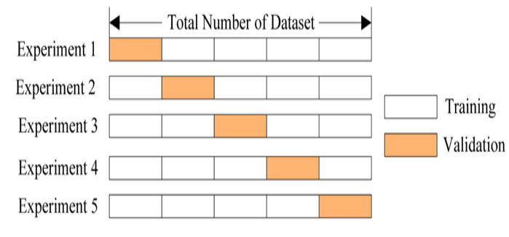
K-Fold Cross Validation
In K Fold cross validation, the data is divided into k subsets and train our model on k-1 subsets and hold the last one for test.
This process is repeated k times, such that each time, one of the k subsets is used as the test set/ validation set and the other k-1 subsets are put together to form a training set.
We then average the model against each of the folds and then finalize our model. After that we test it against the test set
The more the number of folds, less is value of error due to bias but increasing the error due to variance will increase; the more folds you have, the longer it would take to compute it and you would need more memory.

Slide 26
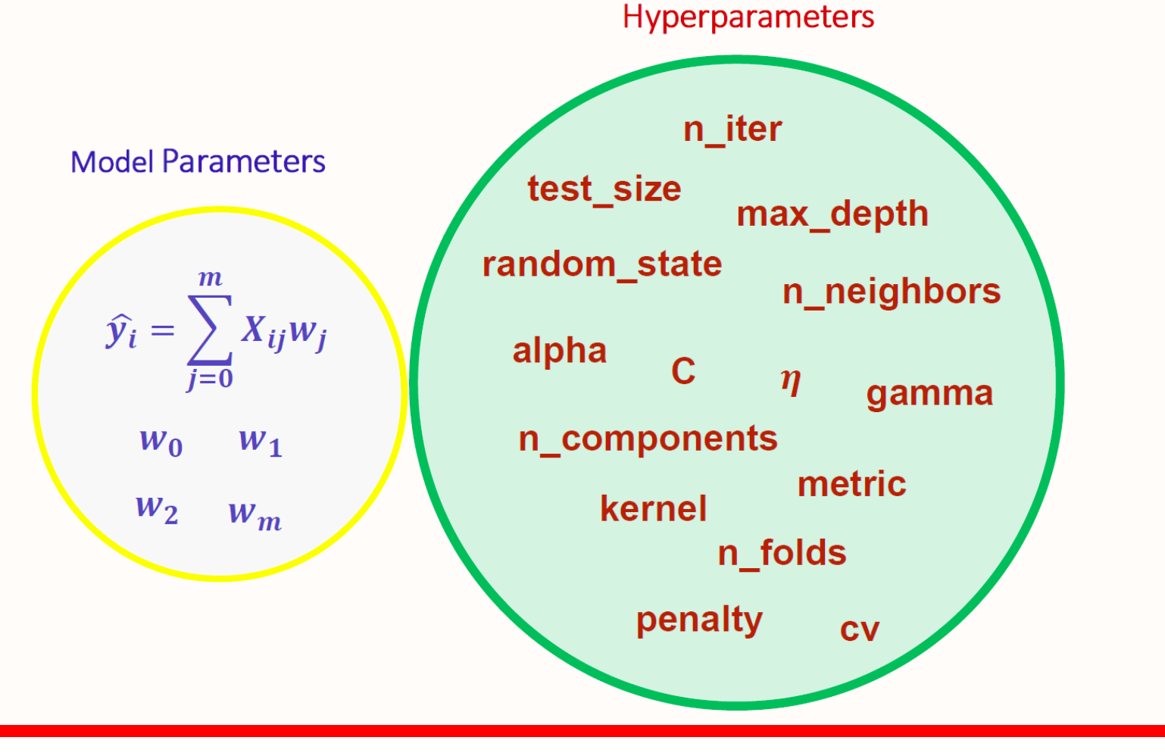
Hyperparameter Tuning
Hyperparameters are external to our model and cannot be directly learned from the regular training process.
These parameters express “higher-level” properties of the model such as its complexity or how fast it should learn.
Hyperparameters are model-specific properties that are ‘fixed’ before you even train and test your model on data.
Currently involves either random search or grid search across sets of hyperparameters.

Slide 27
We have imported two libraries RandomisedSearchCV and GridsearchCV from sklearn.model_selection for performing k-fold cross validation and find the best hyperparameters that describe the model from the infinite space and grid.
The hyperparameters used in the model are:
RandomisedSearchCV
Best parameters found: n_estimators(no of trees used in the model) -100
max_depth(depth or layers of trees used ) - 7
learning_rate(how quickly the model is adapted to the problem.): 0.05.
2. Best Score found: 0.9770745552016705.
GridsearchCV
Best parameters found: n_estimators - 100
max_depth- 8
learning_rate - 0.05
Best Score found: 0.9771519348716857.

Slide 28
A Quick Tour to
Codes

Slide 29
Thank You!!

